Slide 1
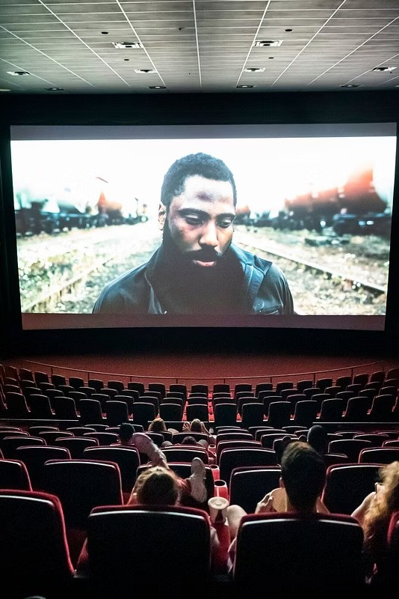


Content Recommendation System
Presented by Nidhish Sharma Student code : iitrprai_24082677 nidhishsharma060504@gmail.com
Minor in AI
IIT Ropar x Masai
Module E

Slide 2
Problem Statement
Finding the right movie is challenging due to the large number of options available. Users often waste time searching and may not get personalized suggestions.
This project develops a Content-Based Recommendation System that recommends movies based on genres, cast, crew, keywords, and overview to provide relevant, user-specific recommendations.
Why Movie Recommendation is Needed?
Abundance of available movies overwhelms users Difficulty in discovering personalized, relevant content Generic recommendation leads to poor user satisfaction
Content-based recommendations leverage movie attributes Improves user engagement by matching preferences to content

Slide 3

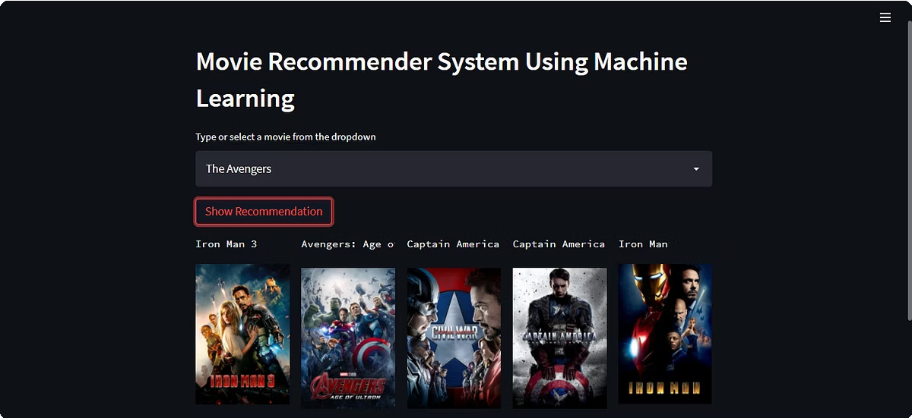
Project Outcome
A fully functional Content Recommendation System web application has been developed using Python and Streamlit. Users can search for a movie and receive a list of similar movies along with their posters. The system effectively analyzes movie features like genres, cast, crew, keywords, and overview to provide personalized recommendations.

Slide 4

Project Objectives
Develop Recommendation System
Create a content-based movie recommendation system tailored for personalized suggestions.
Recommend Movies
Generate recommendations based on similarity of movie content attributes.
Data Preprocessing
Clean and transform raw movie dataset including cast, crew & genres for analysis.
Display Posters
Show movie posters alongside recommendations for enhanced user experience.

Slide 5





Dataset & Tools
The project utilizes the TMDB 5000 Movies Dataset, containing extensive data on:
5,000 movies with detailed metadata
Cast, crew, genres, keywords, and movie overviews
Tools and Libraries:
Python
Pandas
NLTK
Scikit-Learn
Streamlit
Dataset Size: ~5,000 movies

Slide 6
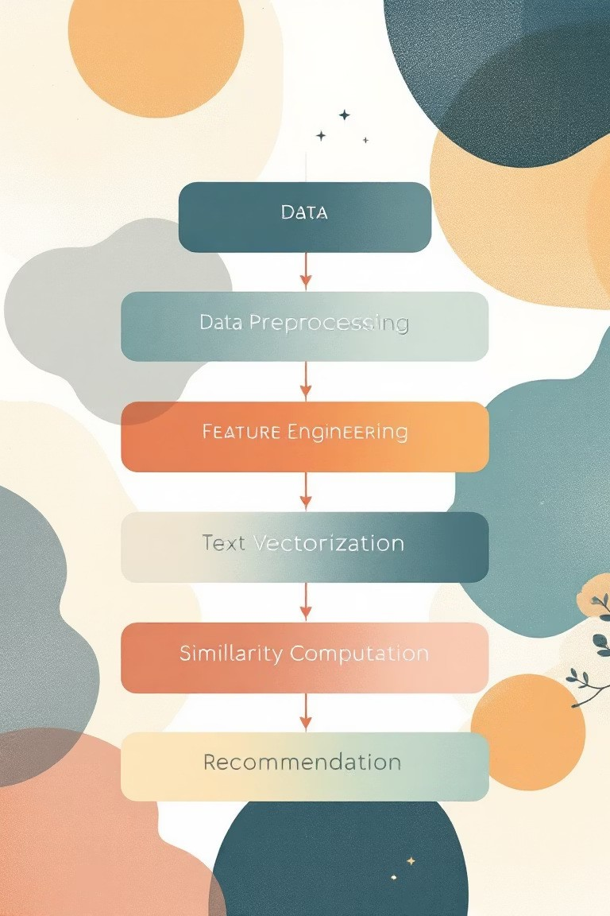


Methodology & Workflow
The step-by-step workflow for the content-based recommendation system:
Data Preprocessing: Clean dataset and extract genres, cast, crew, keywords, and overview
Feature Engineering: Combine attributes into a consolidated 8tags9 column
Text Vectorization: Use CountVectorizer to convert tags into numeric vectors
Similarity Computation: Calculate cosine similarity between movie vectors
Recommendation: Identify and output movies similar to the user9s selected movie

Slide 7



Implementation
Data Collection: Gather movie metadata and details from TMDB.
Datasets:- TMDB 5000 Movies & Credits
Data Preprocessing: Clean, tokenize and merge relevant fields into tags. Extracted genres, cast, crew, keywords, and overview.
Vectorization: Convert text tags into numerical vectors using CountVectorizer
Similarity: Compute Cosine Similarity matrix for recommendation lookup and to measure closeness between movies.
Web App Development: Built an interactive User-Interface using
Streamlit to display recommendations and movie posters.

Slide 8
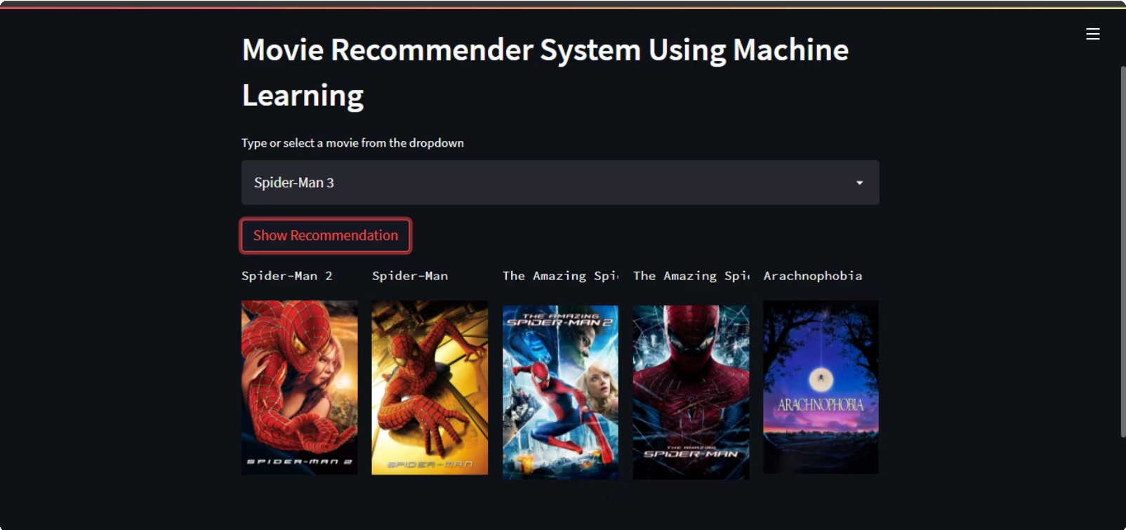

Web-App Demo

Slide 9


Results & Observations
Key outcomes observed from system outputs:
Relevant movie recommendations aligning with user preferences Effective handling of missing or unavailable posters (placeholders used)
System performance is responsive with quick recommendation generation
Limitations include reliance solely on content similarity without user behavior integration
Recommendation Example Observations
Movie A similar to Movie B & C Posters displayed; thematic similarity clear
Missing posters handled gracefully Placeholder images maintain UI consistency

Slide 10

Conclusion & Future Work
The project successfully delivered a content-based movie recommendation system with an intuitive interface and accurate suggestions.
Learnings: Importance of thorough preprocessing and feature engineering for quality recommendations Future Improvements:
Integrate collaborative filtering to incorporate user preferences and ratings Enhance user interface with richer interactivity and filters
Expand dataset to include more movies and multimedia features

Slide 11

Thank You

